Slide 1

Bell Work: Use Unit Circle to Identify the Following:
cos $\frac{3π}{2}$
sin $−\frac{π}{6}$
tan $\frac{π}{3}$
tan $\frac{π}{2}$

Slide 2
Pre-calc trig
Day 33

Slide 3
4.2 Trigonometric Functions: The Unit Circle
Objective: Evaluate trig functions using the unit circle and a calculator

Slide 4
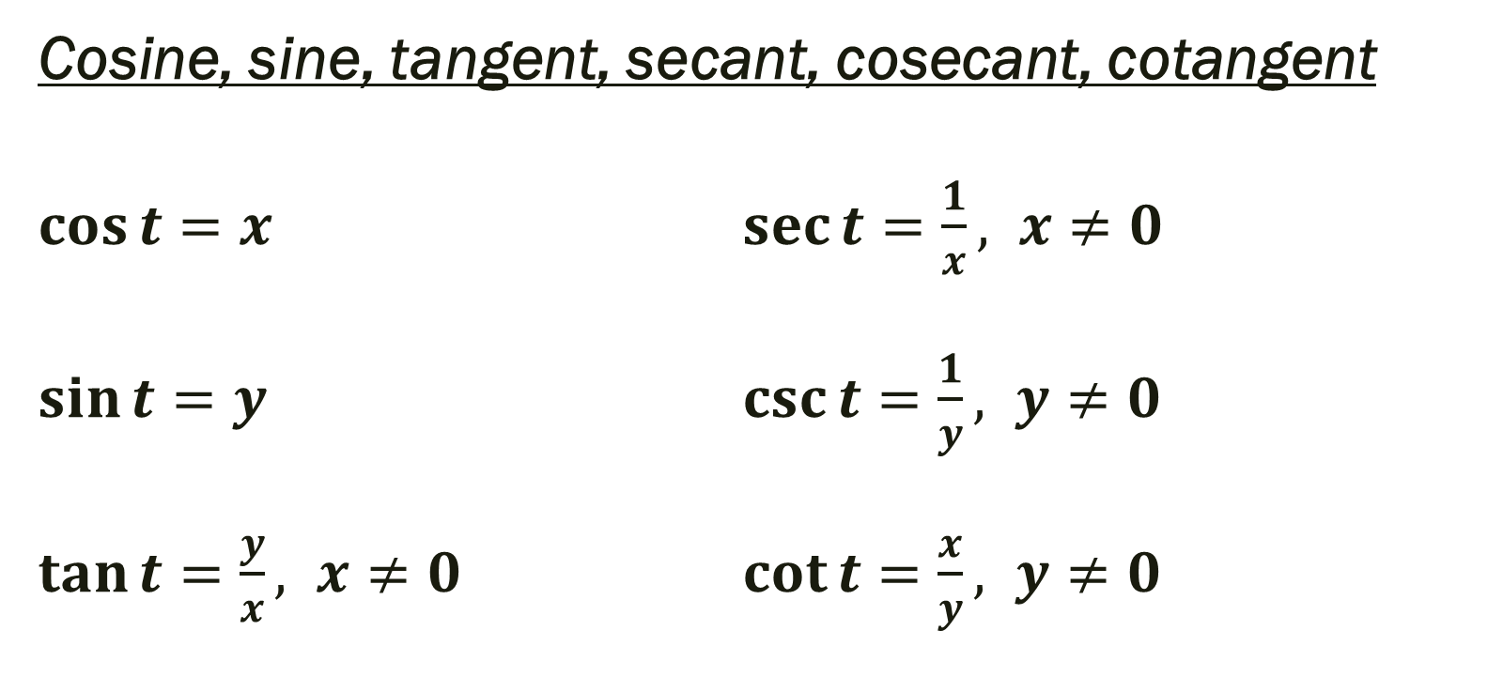
Definitions of Trigonometric Functions Let t be a real number and let (x, y) be the point on the unit circle corresponding to t.
Cosine, sine, tangent, secant, cosecant, cotangent
$\cos{t=x}$ $\sec{t=\frac{1}{x}, x≠0}$
$\sin{t=y}$ $\csc{t=\frac{1}{y}, y≠0}$
$\tan{t=\frac{y}{x}, x≠0}$ $\cot{t=\frac{x}{y}, y≠0}$

Slide 5

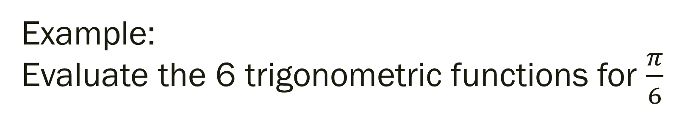
Example: Evaluate the 6 trigonometric functions for $\frac{π}{6}$
$\cos{\frac{π}{6}=}$ $\sec{\frac{π}{6}}=$
$\sin{\frac{π}{6}=}$ $\csc{\frac{π}{6}=}$
$\tan{\frac{π}{6}=}$ $\cot{\frac{π}{6}=}$

Slide 6

Additional Examples
Evaluate the following:
$\cos{\frac{7π}{4}=}$ $\sin{\frac{3π}{2}=}$
$\tan{\frac{5π}{4}=}$ $\sec{\frac{5π}{6}=}$

Slide 7

Additional Examples
Evaluate the following:
$\cos{\frac{7π}{4}=\frac{\sqrt{2}}{2}}$ $\sin{\frac{3π}{2}=−1}$
$\tan{\frac{5π}{4}=1}$ $\sec{\frac{5π}{6}=\frac{1}{\frac{−\sqrt{3}}{2}}=}\frac{−2\sqrt{3}}{3}$

Slide 8
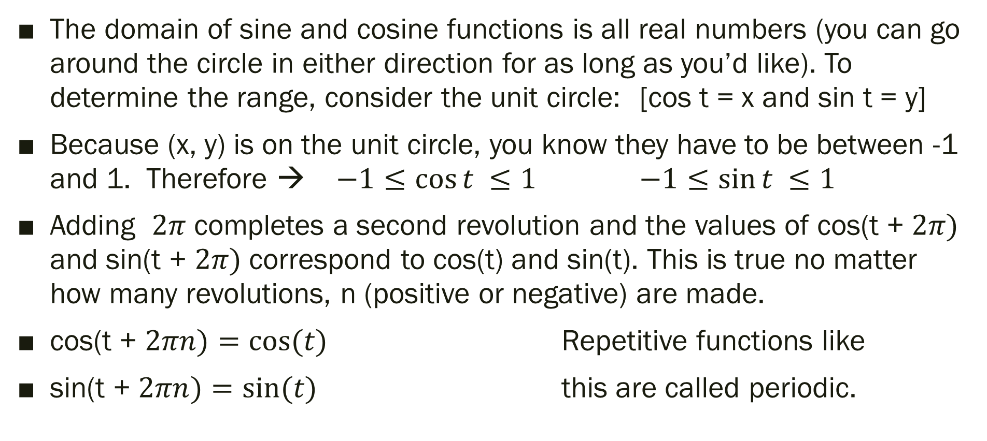
Review: Domain and Range
The domain of sine and cosine functions is all real numbers (you can go around the circle in either direction for as long as you’d like). To determine the range, consider the unit circle: [cos t = x and sin t = y]
Because (x, y) is on the unit circle, you know they have to be between -1 and 1. Therefore → $−1≤\cos{t ≤1}$ $−1≤\sin{t ≤1}$
Adding $2π$ completes a second revolution and the values of cos(t + $2π)$ and sin(t + $2π)$ correspond to cos(t) and sin(t). This is true no matter how many revolutions, n (positive or negative) are made.
cos(t + $2πn)=cos(t)$ Repetitive functions like
sin(t + $2πn)=sin(t)$ this are called periodic.

Slide 9
Even and Odd Trig Functions
Even
Cosine and Secant functions are even.
cos(-t) = cos t sec(-t) = sect t
Odd
Sine, cosecant, tangent, and cotangent functions are odd.
sin(-t) = - sin t csc(-t) = - csc t
tan(-t) = - tan t cot(-t) = - cot t

Slide 10
4.3 Right Triangle Trigonometry
Objective: Evaluate trig functions of acute angles and use fundamental trig identities while solving real-life problems

Slide 11
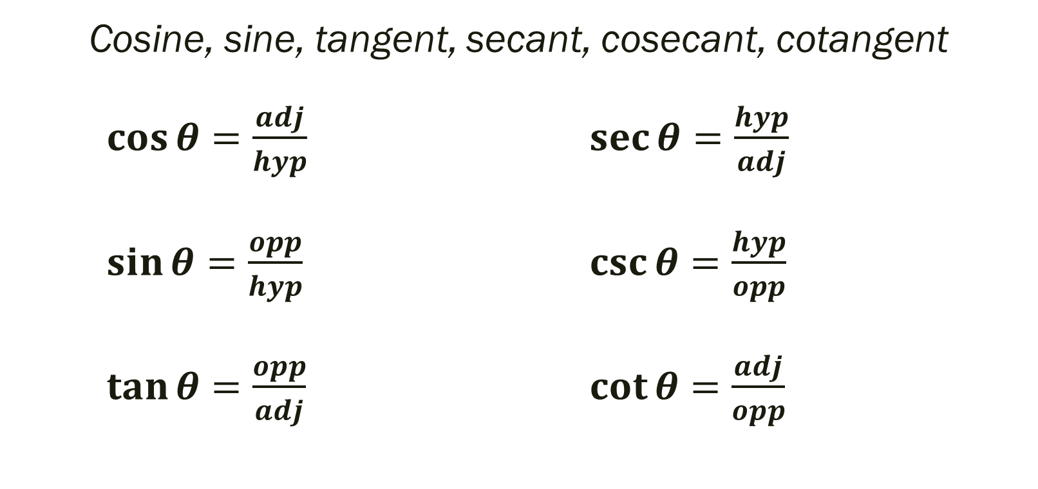

Right Triangle Definitions of Trigonometric Functions Let $θ$ be an acute angle of a right triangle. The six trig functions of angle $θ$ are defined:
Cosine, sine, tangent, secant, cosecant, cotangent
$\cos{θ=\frac{adj}{hyp}}$ $\sec{θ=\frac{hyp}{adj}}$
$\sin{θ=\frac{opp}{hyp}}$ $\csc{θ=\frac{hyp}{opp}}$
$\tan{θ=\frac{opp}{adj}}$ $\cot{θ=\frac{adj}{opp}}$

Slide 12
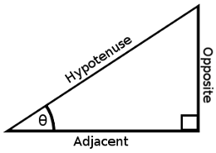
----SOH----CAH----TOA----
The abbreviations in the previous slide: opp, adj, hyp
represent the lengths of the sides of the right triangle
(as seen in the picture)
opp = length of side opposite given θ
adj = length of side adjacent to given θ
hyp = length for of hypotenuse

Slide 13

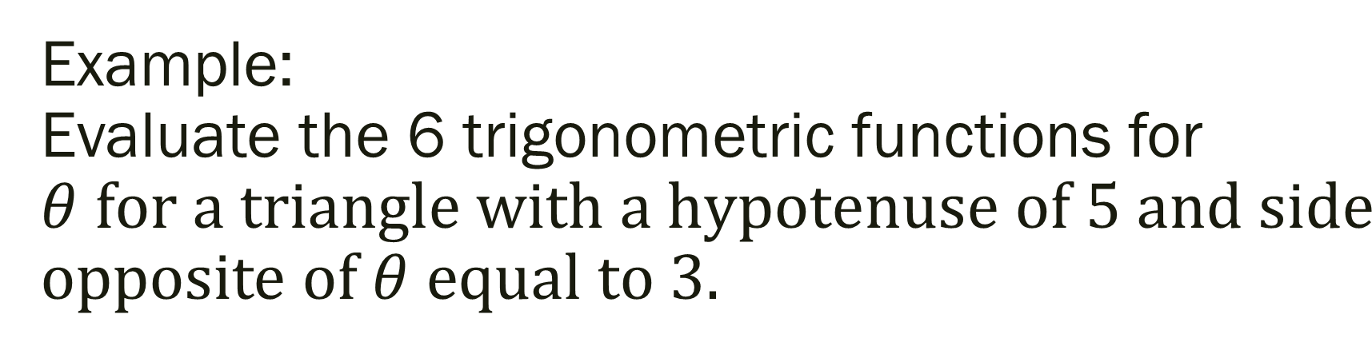
Example: Evaluate the 6 trigonometric functions for $θ for a triangle with a hypotenuse of 5 and side$ opposite of $θ equal to 3.$
$\cos{θ=}$ $\sec{θ}=$
$\sin{θ=}$ $\csc{θ=}$
$\tan{θ=}$ $\cot{θ=}$

Slide 14
Fundamental Trigonometric Identities
These identities will be vital as we move through this chapter and into second semester

Slide 15

Reciprocal Identities
$\cos{θ=\frac{1}{sec θ}}$ $\sec{θ=\frac{1}{cos θ}}$
$\sin{θ=\frac{1}{csc θ}}$ $\csc{θ=\frac{1}{sin θ}}$
$\tan{θ=\frac{1}{cot θ}}$ $\cot{θ=\frac{1}{tan θ}}$

Slide 16

Quotient Identities
$\tan{θ=\frac{sin θ}{cos θ}}$ $\cot{θ=\frac{cos θ}{sin θ}}$

Slide 17

Pythagorean Identities
$\sin^{2}θ+cos^{2}θ=1$
Therefore, $1+tan^{2}θ=\sec^{2}θ$
But how? $1+cot^{2}θ=c{sc}^{2}θ$

Slide 18

Example
Let $θ$ be an acute angle such that sin $θ=0.6$. Find the value of:
1.) cos$θ$
2.) tan $θ$

Slide 19
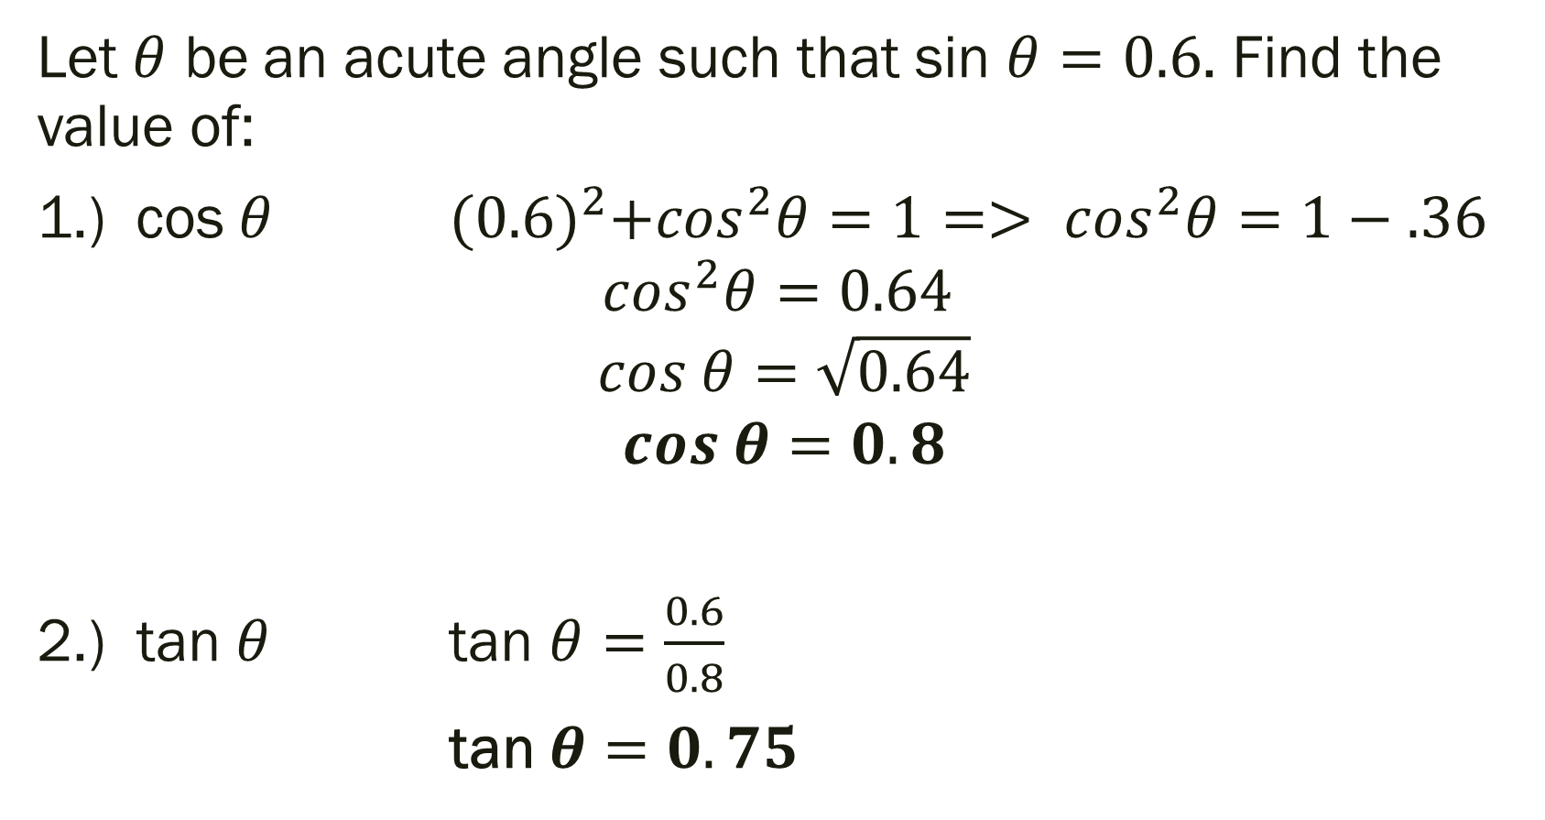
Solution:
Let $θ$ be an acute angle such that sin $θ=0.6$. Find the value of:
1.) cos$θ$ ${(0.6)}^{2}+cos^{2}θ=1=> cos^{2}θ=1−.36$
$$cos^{2}θ=0.64$$
$$cos θ=\sqrt{0.64}$$
$$cos θ=0.8$$
2.) tan $θ$ tan $θ=\frac{0.6}{0.8}$
tan $θ=0.75$

Slide 20
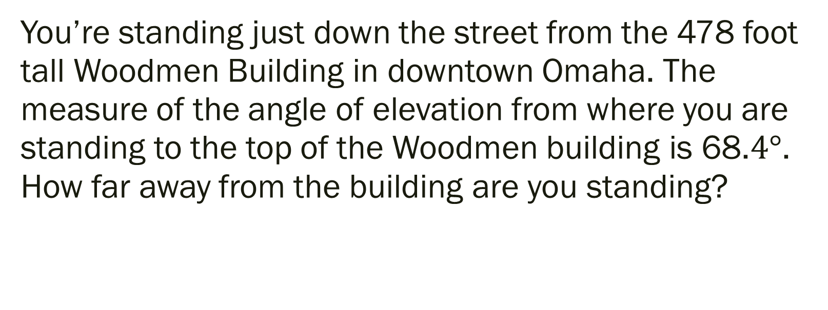
Example: Applications to Real Life
You’re standing just down the street from the 478 foot tall Woodmen Building in downtown Omaha. The measure of the angle of elevation from where you are standing to the top of the Woodmen building is 68.$4°$. How far away from the building are you standing?

Slide 21
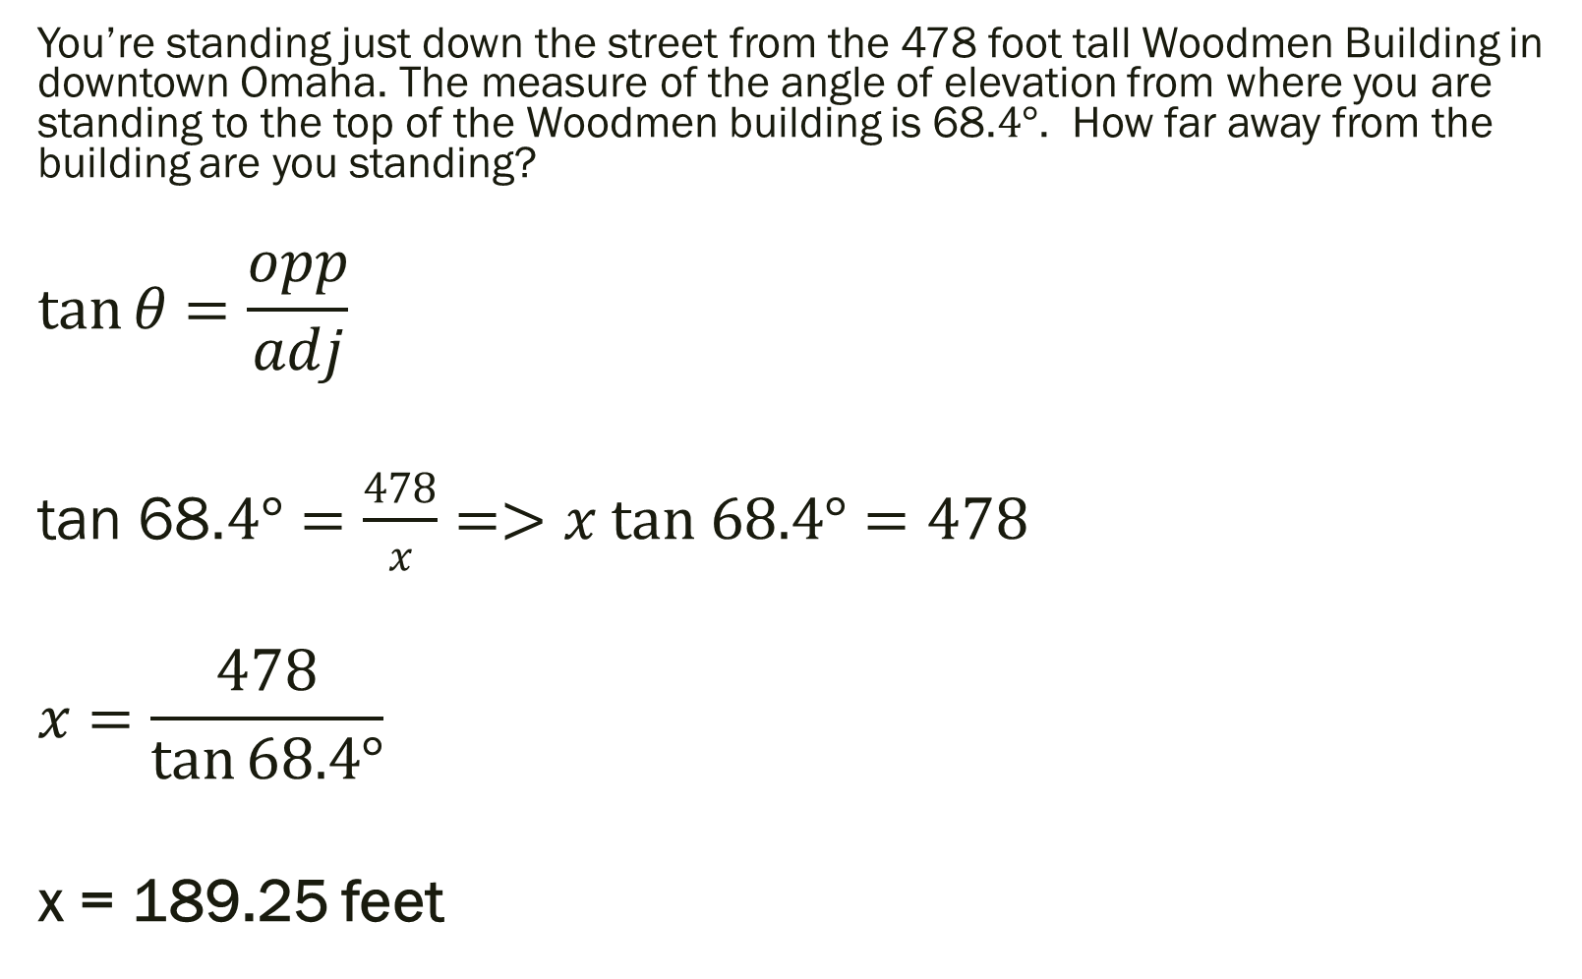
Solution:
You’re standing just down the street from the 478 foot tall Woodmen Building in downtown Omaha. The measure of the angle of elevation from where you are standing to the top of the Woodmen building is 68.$4°$. How far away from the building are you standing?
$$\tan{θ=\frac{opp}{adj}}$$
tan 68.$4°=\frac{478}{x}=>x tan 68.4°=478$
$$x=\frac{478}{\tan{68.4°}}$$
x = 189.25 feet

Slide 22

Example: Second Application
A historic lighthouse is 200 yards directly south from a bike path along a lake. A walk way to the lighthouse is 400 yards long. Find the acute angle $θ$ between the bike path and the walkway.

Slide 23
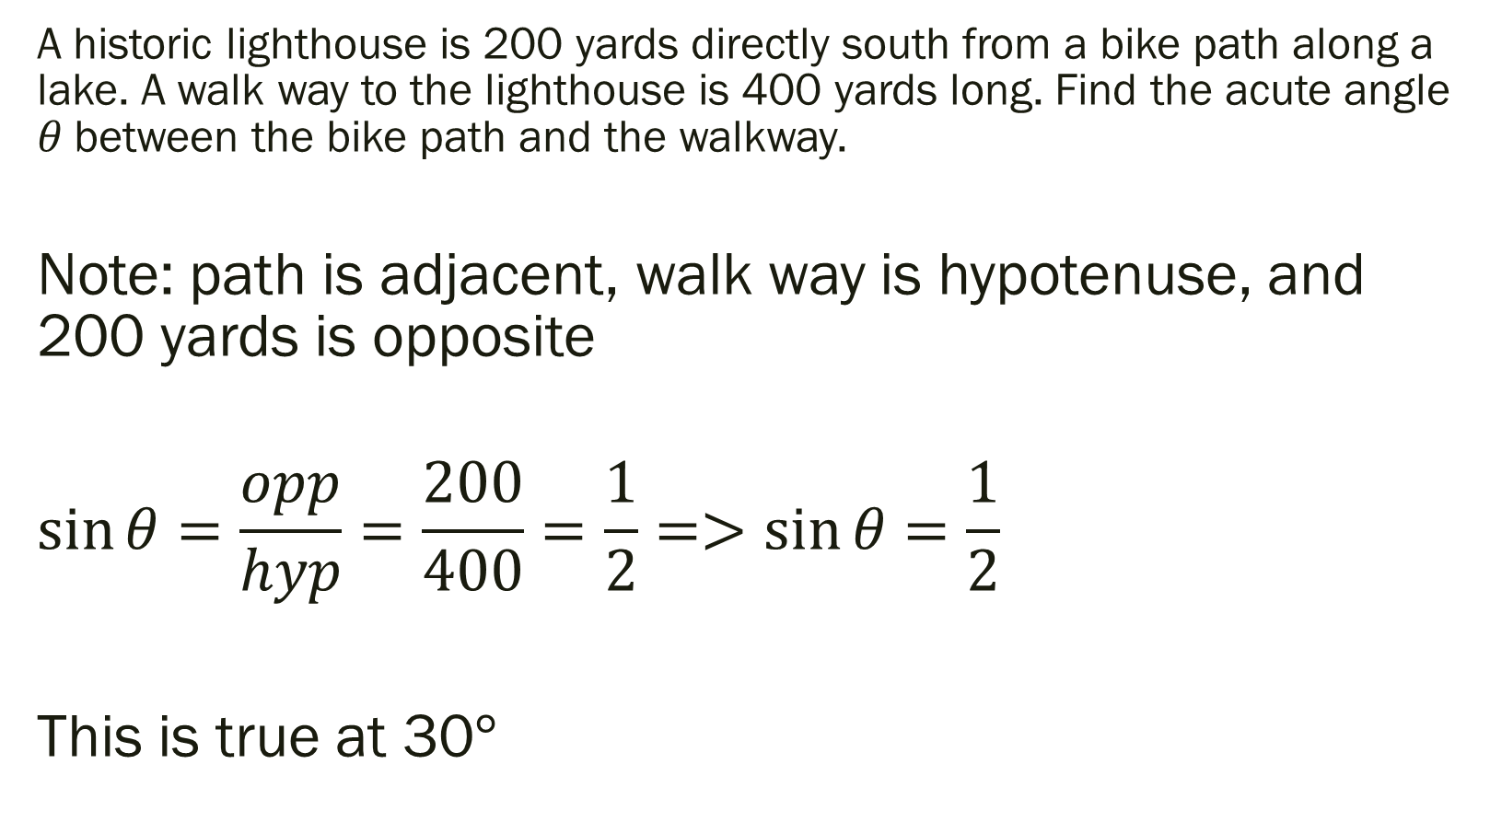
Example: Second Application
A historic lighthouse is 200 yards directly south from a bike path along a lake. A walk way to the lighthouse is 400 yards long. Find the acute angle $θ$ between the bike path and the walkway.
Note: path is adjacent, walk way is hypotenuse, and 200 yards is opposite
$$\sin{θ=\frac{opp}{hyp}=\frac{200}{400}=\frac{1}{2}=>\sin{θ=\frac{1}{2}}}$$
This is true at 30$°$

Slide 24
For Next Time
Pg 297 #5, 9-19 (odd), 27, 34, 49-53 (odd), 59
Get a Head Start…
Pg 306 #1, 5-6, 30-31, 37-40, 45, 47, 57, 63-64, 67, 71

